Slide 1
Driving sustainability IN SUPPLY CHAINs Through Innovation and Financial Incentive
December 2018

Slide 2
A member of the World Bank Group
Provides investment, advice, resource mobilization
Triple-A credit rating; owned by 184 countries
Present in nearly 100 countries
IFC is the largest global development institution focused on the private sector in emerging markets.

Slide 3
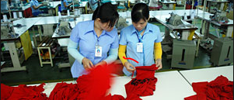
GTSF: IFC’s Commitment to Address Global Competitiveness of Supply Chains
GTSF (Global Trade Supplier Finance) is a US$ 500 million multicurrency finance program launched in 2010.
Provides affordable short-term financing to Suppliers in emerging markets
IFC provides cash to Suppliers 2 days after the Buyer accepts to pay. This compares to waiting 30-120 days for Suppliers to receive payment from Buyers.
Pricing is based on the Buyer’s credit rating, not the Supplier’s, creating cost-savings opportunities for Suppliers and for the supply chain.
GTSF encourages improved environmental and social performance of Suppliers through differentiated pricing based on Supplier Sustainability rating.

Slide 4
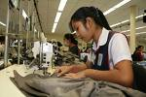
Project Example: PUMA (via Platform Partner GT Nexus)
Supply Chain
Finance
Platform
Buyer
Emerging Market
Suppliers
Platform gives real time visibility into buyer and suppliers transactions (e.g. contract, purchase order, e-invoice, payment, etc.),
Provides data to better measure risks

Slide 5
GTSF’s Sustainability Pricing Can Help Build the Business Case for Certification
GTSF’s interest rates are linked to the supplier’s environmental & social performance, effectively giving suppliers a financial incentive to improve and/or maintain certification status.
GTSF works with buyers to determine interest rates corresponding to each eligible compliance level. The better the compliance level, the lower the interest rate.
Supplier’s Sustainability Compliance Rating | Supplier’s Annual Interest Rate
Gold | Lowest Interest Rate
Silver | Lower Interest Rate
Bronze | Standard Interest Rate
Non-Compliant | Ineligible for GTSF

Slide 6
Illustration: GTSF Annual Cost Savings By Jurisdiction
Factory Location
Bangladesh
Vietnam
Vietnam
Supplier’s Invoicing Location
Bangladesh
Vietnam
Hong Kong
Supplier’s
Annual Sales
$50 million
Existing Annual Financing Cost for Supplier (Working Capital Loan from Bank)
$500,000
6% p.a.
$250,000
3% p.a.
$104,000
1.25% p.a.
GTSF Annual Financing Cost for Supplier
$83,000
1% p.a.
GTSF Annual Savings from Compliance Improvements for Supplier
($17,000)
0.20% p.a.*
Total Annual GTSF Savings for Supplier
$434,000
$184,000
$38,000
*Savings assuming E&S improvement from baseline, corresponding with 20bps lower interest rate, as specified in E&S pricing grid.

Slide 7
Partnership for Cleaner Textile
Advisory
Services
Going Beyond Low-Hanging Resource Efficiency Projects for Greater Developmental Impacts
IFC’S PROGRAMMATIC APPROACH
FOR HOLISTIC SUSTAINABILITY SOLUTIONS
Demonstrate Business Case
Access to Finance
Sector Scale-Up
Practical manufacturing supply chain solutions to address climate risks, reduce operating costs, and increase productivity
Simple low-cost modifications as well as more expensive and complex projects with good developmental impacts
Beyond consultant audits and studies to project implementation, financing facilitation, and sector scale-up
Leverage impacts by engaging with multiple global brands, NGOs, associations, and government stakeholders

Slide 8
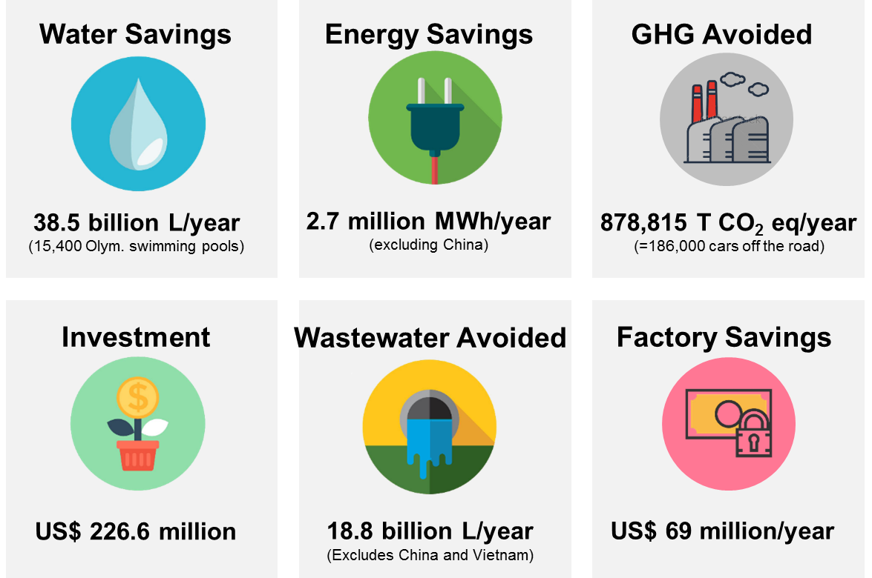
Creating Tangible Impacts for Apparel, Textile & Footwear Sector
Advisory
Services
IFC Resource Efficiency Programs in Bangladesh, China & Vietnam
Source: IFC

Slide 9
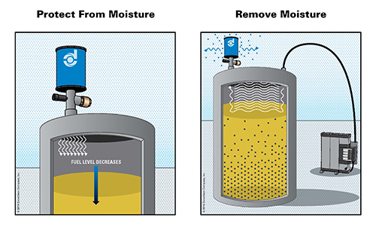
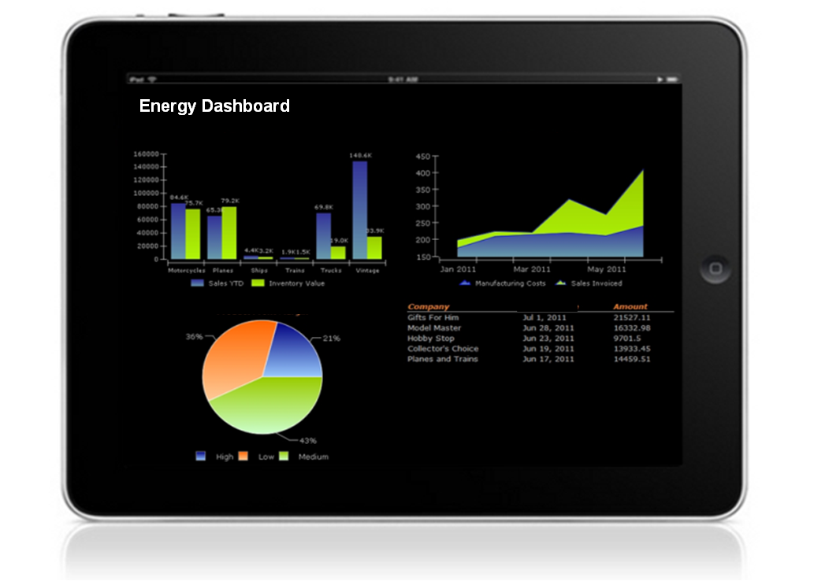
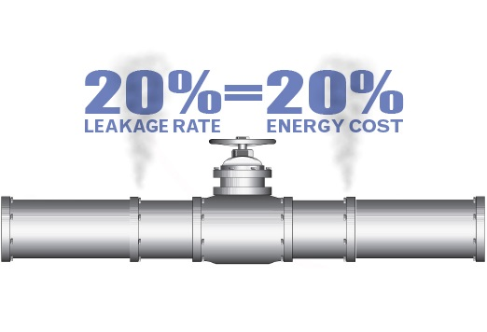
Examples of Using Working Capital to Improve Environmental Performance
Software Energy Control
Cost: USD 2,380
Resource Saved: 250,795 kWh/y
Monetary Savings: USD 45,588
Payback: less than 3 months
Moisture Reduction in Fuel
Cost: USD 6,897
Resource Saved: 961 tons/y
Monetary Savings: USD 55,497
Payback: 2 months
Compressed Air Leak Reduction
Cost: USD 30,250
Resource Saved: 946,080
Monetary Savings: USD94,600
Payback: less than 4 months
Power Factor Improvement
Cost: USD 14,533
Resource Saved: 326,321 kWh/y
Monetary Savings: USD 32,494
Payback: 5 months

Slide 10
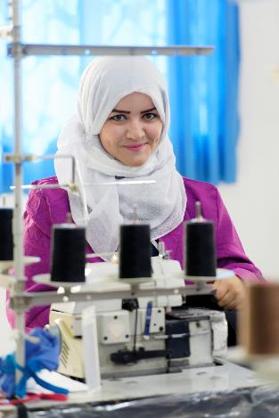
Supplier Financing Can Positively Impact Workers
2016 Independent Impact Evaluation of
Beginning in 2009, an independent interdisciplinary team from Tufts University gathered and analyzed data on 15,000 garment workers and 2,000 factory managers in 5 countries.
Key Findings
Factories with better labor practices are more productive, more profitable and have better business terms with buyers, including larger order sizes.
Longer payment terms from buyers to suppliers result in later and lower payments to the workers. This suggests that supplier finance which accelerates payments to suppliers, will result in higher, on-time payments to workers.
Source: Better Work

Slide 11
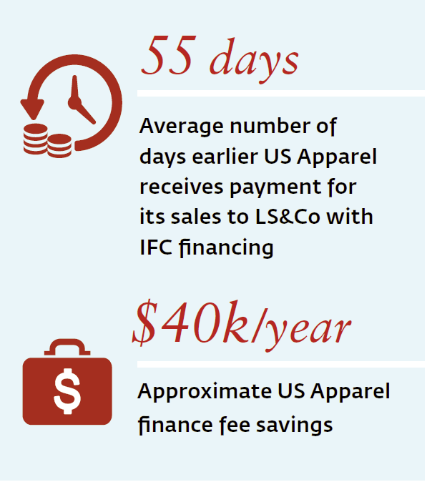
IFC & Levi’s Partnership Put US Apparel & Textiles on Model Vendor Track
Company Profile: US Apparel
US Apparel & IFC Financing
Vertically integrated apparel company based in Lahore, Pakistan;
Employs 15,000 people and produces 28 million meters of fabric per year;
Levi’s supplier since 2009;
Sustainability Achievements
Increased Environment/Social score from 5 to 7 (out of 10) by implementing new compliance strategy focusing on worker well-being and the environment;
Expanded compliance team from 12 to 30;
Implemented trainings on worker health and safety, personal finance and personal health;
Upgraded equipment to include water saving technology, more efficient and cleaner models, and solar panels;

