Slide 1

Positive impact initiative rethinking impact to finance the sdgs
3rd december 2018, brussels

Slide 2









The positive impact initiative
WHO
Banks & Investors
But also corporate & public sector:
WHAT
A business approach to financing the SDGs
The SDG financing gap is symptomatic of a business model gap. Impacts can be used as a starting point for business models and generate revenues. This can reduce costs, address certain risk issues and catalyse private sector solutions.
The financial sector needs to embrace holistic impact analysis.

Slide 3
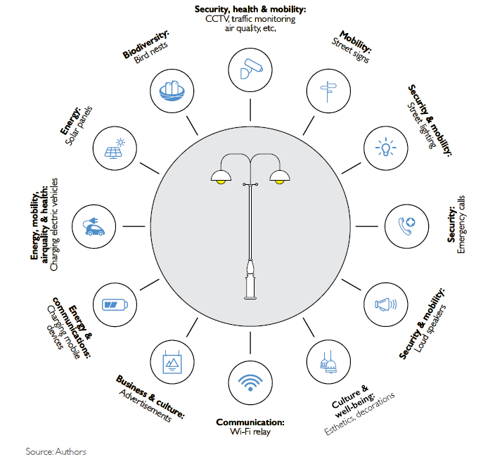



Towards impact-based business models
Traditional lampost, traditional business model, public financing
Multi-functional lamp-post, traditional business model, public finance with savings (improved cost-impact ratio)
Multi-functional lampost, impact-based business model, private finance
Notes:
Mix of services, for different audiences
Reduction of cost-to-impact ratio
Repayment of investment via multiple service contracts (run by the company, by the municipality or by a dedicated intermediary)
Risk enhancement : shifted counterparty risk
Savings for the public sector
-----
Can positive impacts generate revenues and financial flows?
Two core principles:
Work back from the desired impact to build the right solution
Look for multi-impact solutions, i.e. address as many impacts as possible in one go.
Inherent benefits:
Lower cost to impact
Risk enhancement

Slide 4
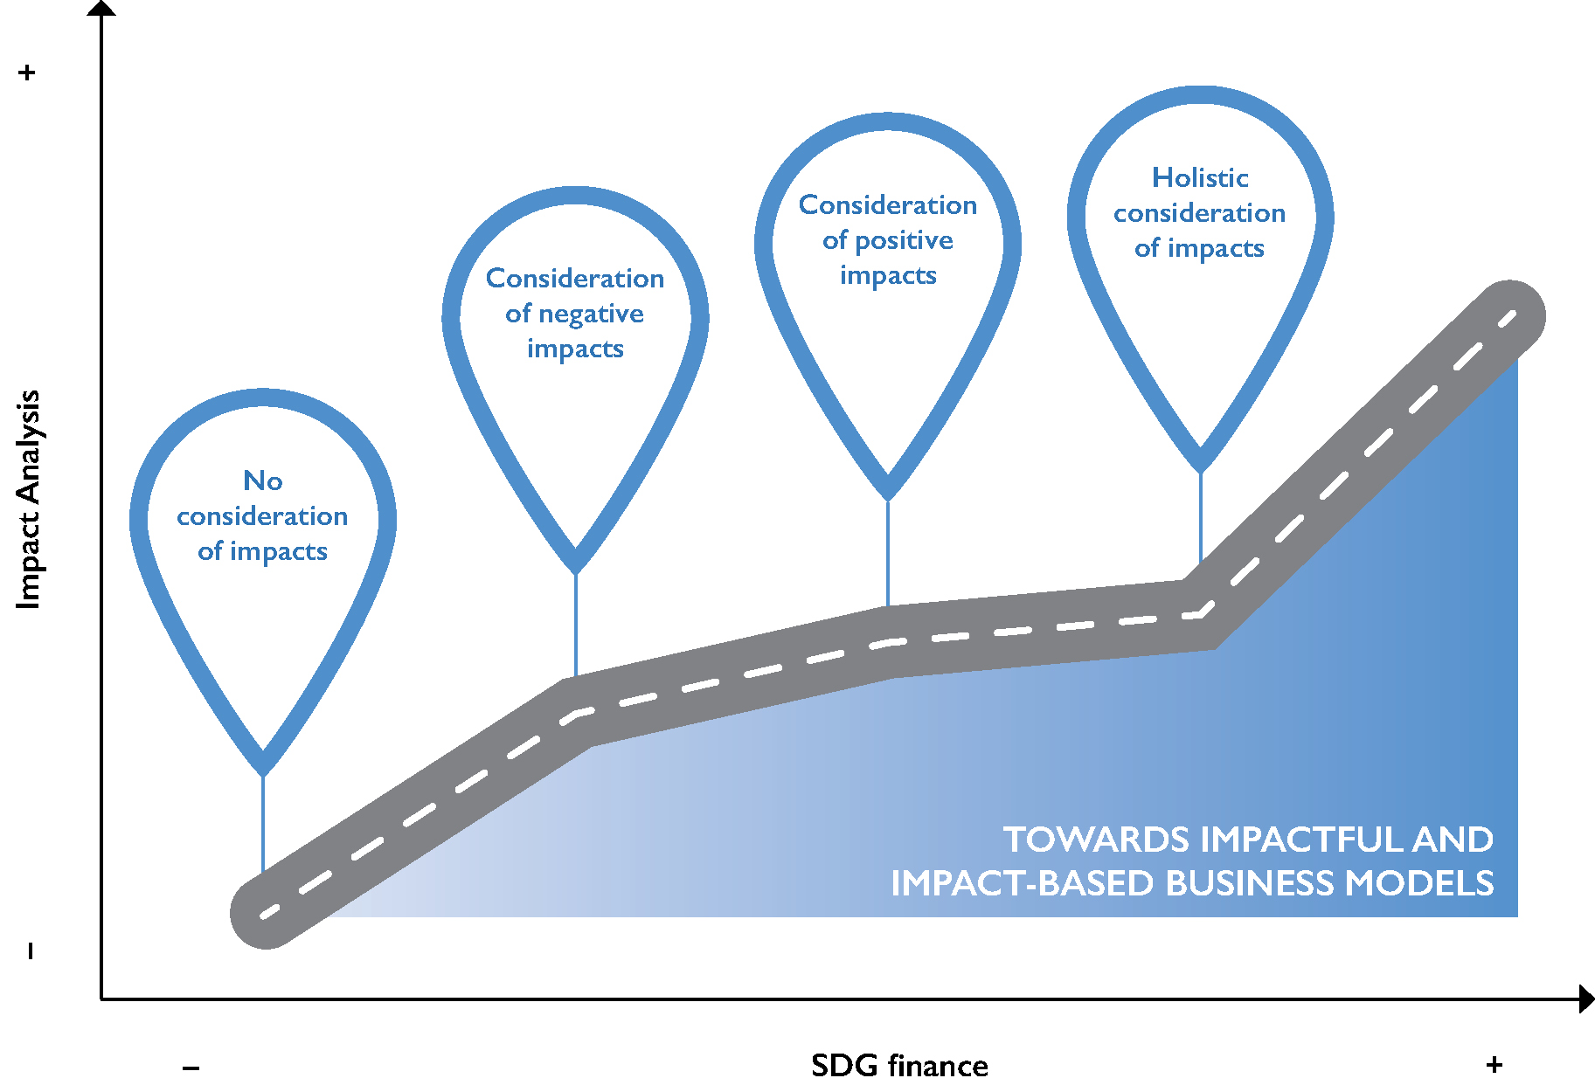
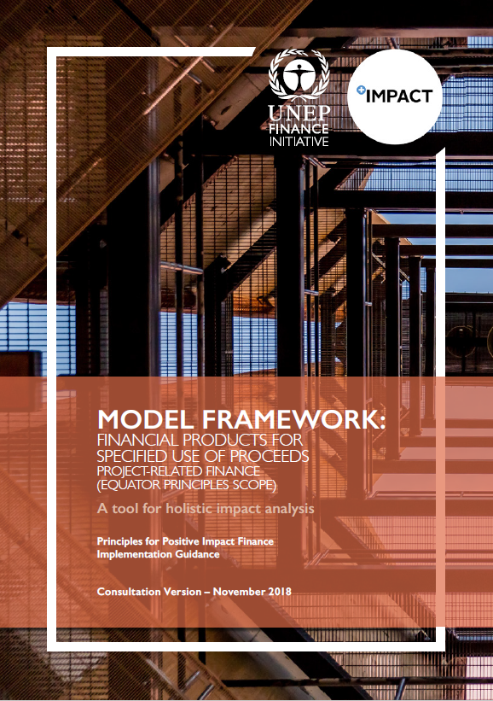
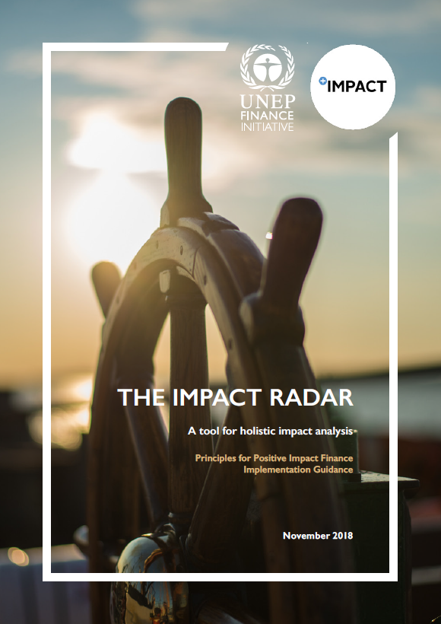

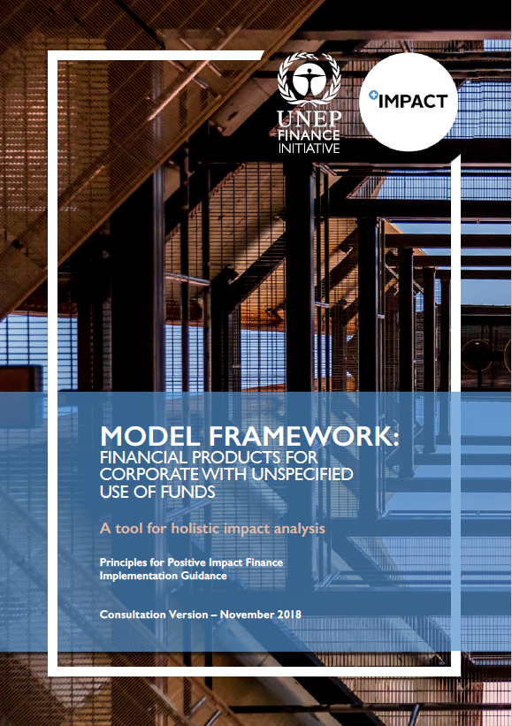

Offering
Supply Side:
The Principles for Positive Impact Finance
«Positive Impact Finance is that which serves to finance Positive Impact Business. It is that which serves to deliver a positive contribution to one or more of the three pillars of sustainable development, once any potential negative impacts to any of the pillars have been duly identified and mitigated.»

Slide 5
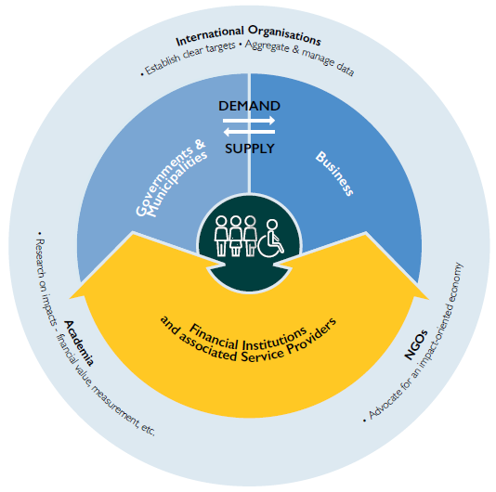
Offering
Demand Side:
Impact-based business models and programmes
Engagement with corporates and government authorities at the local level
Members pilot in Morocco

Slide 6
Possible SYNERGIEs
Promoting sustainable financial institutions
UNEP FI membership
PI reporting and products
Promoting impact-based business and finance
Dissemination of «Rethinkning Impact»
Replication of Moroccan pilot
Research on impact-based business models
Impact metrics
Translating macro-economic goals into impacts useable by the private sector
Setting context-specific baselines and targets

Slide 7
#positiveimpactnews
www.unepfi.org/positive-impact
positiveimpact@unepfi.org

