Slide 1
One Planet
Sharing knowledge and information and taking part in the global progress review on SCP / SDG12
Fabienne Pierre, Ph.D., 10YFP Secretariat / One Planet network
UN Environment

Slide 2
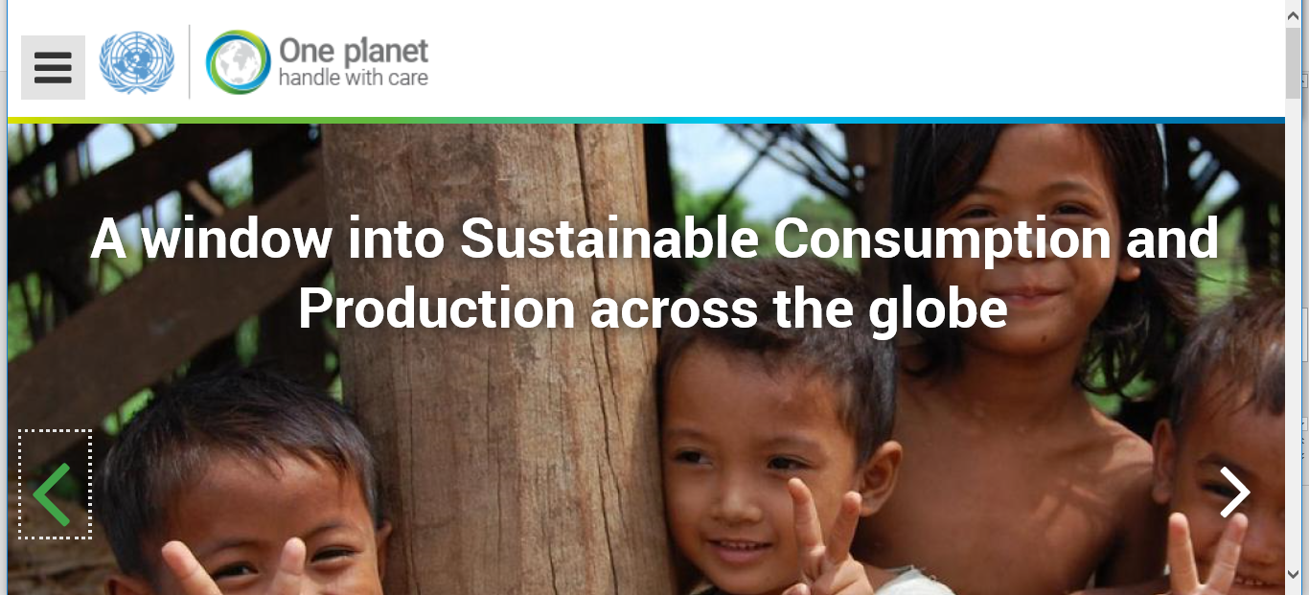
A global platform for knowledge sharing and networking

Slide 3
Make it count!
You, your team and your organization are contributing to the shift to sustainable consumption and production patterns ? We are excited to learn the details of your work so that we can effectively communicate the progress of the global SCP movement!

Slide 4
How to share information on projects and activities?
Log in to “My SCP”
2 ways to report
Upload a project in the database, and then report on activities within that project from My SCP: your project will be featured on our website, and including in our global progress review on SCP to HLPF
Report on an activity not related to a project: your activities will be included in our global progress review on SCP only

Slide 5
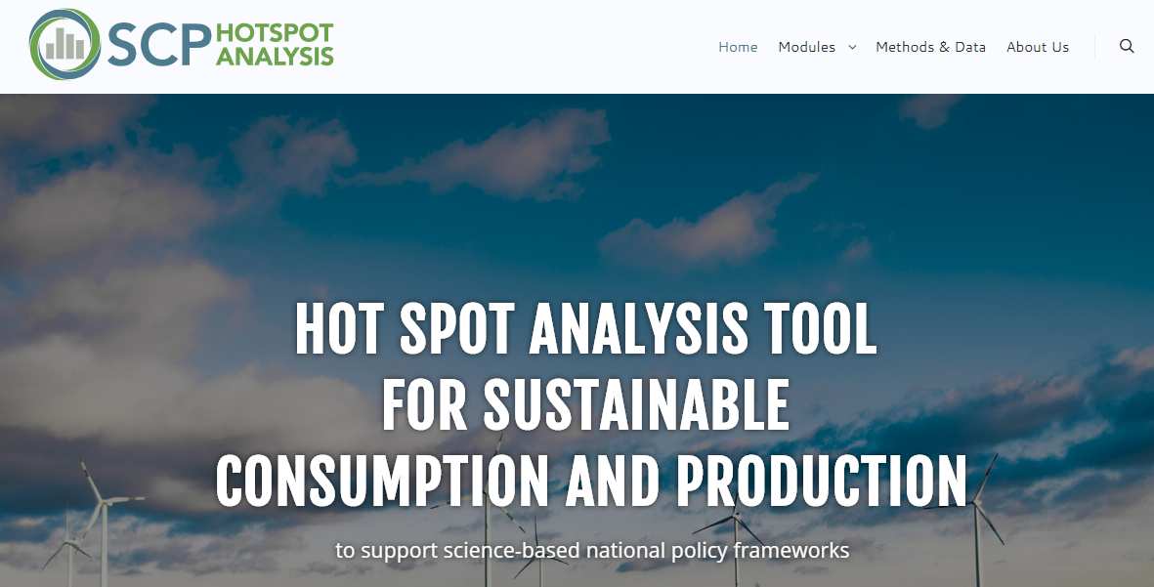
SCP Hotspot Analysis Tool
Objectives: support science-based SCP policy making
The tool provides the necessary figures and numbers to point policy makers and their consultants towards the areas where action is most needed.

Slide 6
