Slide 1
Inclusive green economy in EU development cooperation
A DEVCO Training Course
Notes:
1

Slide 2
Key messages:
IGE is given growing attention in EU international cooperation policy;
IGE can contribute to EU broader EU priorities but links need to be clearly communicated;
There is already a significant portfolio of actions on IGE in EU international cooperation.

Slide 3
Chronology of relevant policy commitments supporting the IGE
2011: EU Communication on Rio+20
2011: Agenda for Change
2014: President Juncker political guidelines
2014: Private Sector Communication
2015: 2030 Agenda for Sustainable Development
2017: New EU Consensus on development
Notes:
Communication Rio+20: A strong commitment to IGE; Proposes a pathway "towards IGE and better governance"
Agenda for Change: Provides a definition: EU DEV policy should promote a ‘green economy’ that generates growth, create jobs and help reduce poverty
Private Sector Communication: Highlights IGE as a priority area for private sector development
2030 Agenda: no explicit reference to GE; concept is embedded across the Agenda
New EU Consensus: IGE as part of the planet priority and the prosperity priority, in particular in the context of the External Investment Plan
Consistent attention to the IGE in EU development policy; sometimes through other concepts

Slide 4
Agenda for Change:
“EU development policy should promote a ‘green economy’ that can generate growth, create jobs and help reduce poverty by valuing and investing in natural capital, including through supporting market opportunities for cleaner technologies, energy and resource efficiency, low-carbon development while stimulating innovation, the use of ICT, and reducing unsustainable use of natural resources”
Notes:
Communication Rio+20: A strong commitment to IGE; Proposes a pathway "towards IGE and better governance"
Agenda for Change: Provides a definition: EU DEV policy should promote a ‘green economy’ that generates growth, create jobs and help reduce poverty
Private Sector Communication: Highlights IGE as a priority area for private sector development
2030 Agenda: no explicit reference to GE; concept is embedded across the Agenda
New EU Consensus: IGE as part of the planet priority and the prosperity priority, in particular in the context of the External Investment Plan
Consistent attention to the IGE in EU development policy; sometimes through other concepts

Slide 5
Private Sector Development Communication:
“Promote eco-entrepreneurships and green job creation through the SWITCH TO GREEN flagship that... ... combines policy dialogue on enabling conditions for green business development with co-funding of innovative projects that support sustainable consumption and production patterns and practices...“
Notes:
Communication Rio+20: A strong commitment to IGE; Proposes a pathway "towards IGE and better governance"
Agenda for Change: Provides a definition: EU DEV policy should promote a ‘green economy’ that generates growth, create jobs and help reduce poverty
Private Sector Communication: Highlights IGE as a priority area for private sector development
2030 Agenda: no explicit reference to GE; concept is embedded across the Agenda
New EU Consensus: IGE as part of the planet priority and the prosperity priority, in particular in the context of the External Investment Plan
Consistent attention to the IGE in EU development policy; sometimes through other concepts

Slide 6
The new European Consensus: EU response to the 2030 Agenda
In November 2016, the European Commission set out a strategic approach for sustainable development in Europe and around the world:
Communication on next steps for a sustainable European future
Proposal for a new European Consensus on Development
Communication on a renewed partnership with ACP countries
Notes:
The EU's answer to the 2030 Agenda will include two work streams:
The first work stream, presented in the Communication on the next steps for a sustainable European future is to fully integrate the SDGs in the European policy framework and current Commission priorities, assessing where we stand and identifying the most relevant sustainability concerns.
A second track will launch reflection work on further developing our longer term vision and the focus of sectoral policies after 2020, preparing for the long term implementation of the SDGs. The new Multiannual Financial Framework beyond 2020 will reorient EU budget's accordingly

Slide 7
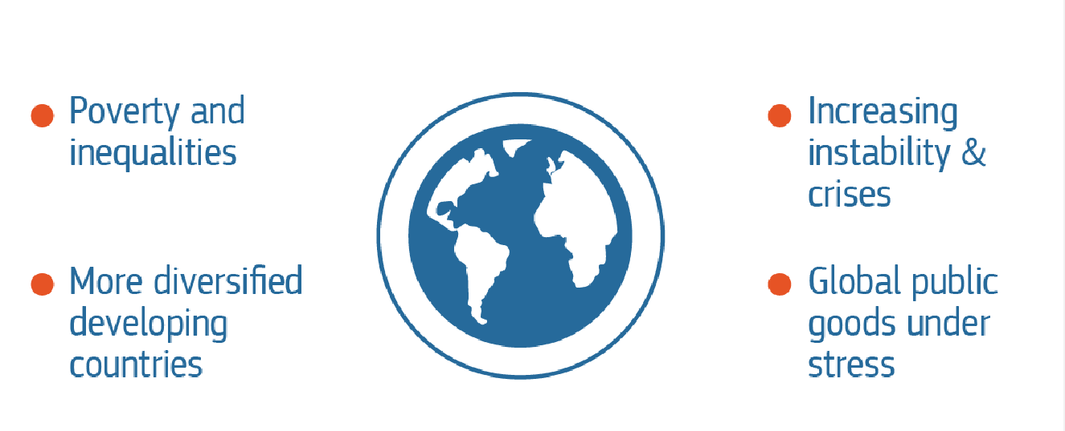
Why a new European Consensus: New global challenges

Slide 8
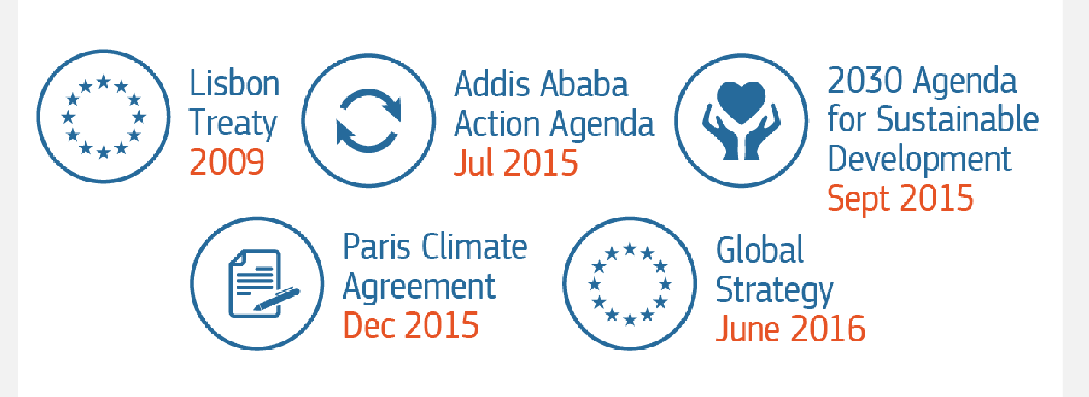
Why a new European Consensus: A new EU and international framework

Slide 9
A new Consensus structured around 5 Priorities
Notes:
The structure of the new Consensus (around the 5 Ps) reflects the objectives of EU external action set out in the article 21.2 of the TEU.

Slide 10
Green Economy in the new Consensus
Prosperity: "promote SCP, circular economy, scaling-up private and public investments in green economy";
Planet: "resource efficiency and SCP, sustainable management of natural resources, natural capital accounting";
People: Strong links to education and jobs, including in the context of efforts to address the root causes of irregular migration through growth and employment opportunities
Peace: Environmental degradation incl. climate change among root causes of poverty, conflict, fragility, humanitarian need and forced displacement

Slide 11
Programme level priorities
SCP practices by businesses and consumers (e.g. SWITCH programmes)
Enabling policy and regulatory frameworks (e.g. SWITCH, PAGE, GEC)
Green investments (SWITCH, investment facilities…)

Slide 12
Main ongoing EU funded IGE programmes
SWITCH Asia | EUR 135 M + 120 M
SWITCH Med | EUR 23 M
EAP Green | EUR 10 M
SWITCH Africa | EUR 19M + 20 M
Partnership for Action on Green Economy (PAGE) / Green Economy Coalition (GEC) | EUR 11 M
EU - UNEP Strategic Cooperation Agreement (RE / GE / SCP) Resource Efficiency and Eco-Innovation Sustainable Public Procurement and Eco-labeling, International Resource Panel Life-cycle approach in international supply chains 10 YFP GE measurement Inquiry into the design of a sustainable financial system GE and trade | EUR 15 M (apr.)

Slide 13
Future developments
New Consensus expected to be signed jointly at the European Development Days (June 2017)
From policy to action?
Implementation of EU circular economy action plan likely to have impact on IGE international cooperation priorities
Opportunity to give attention to IGE in the coming years, following the Mid Term Review of EU international cooperation programmes

