Slide 1
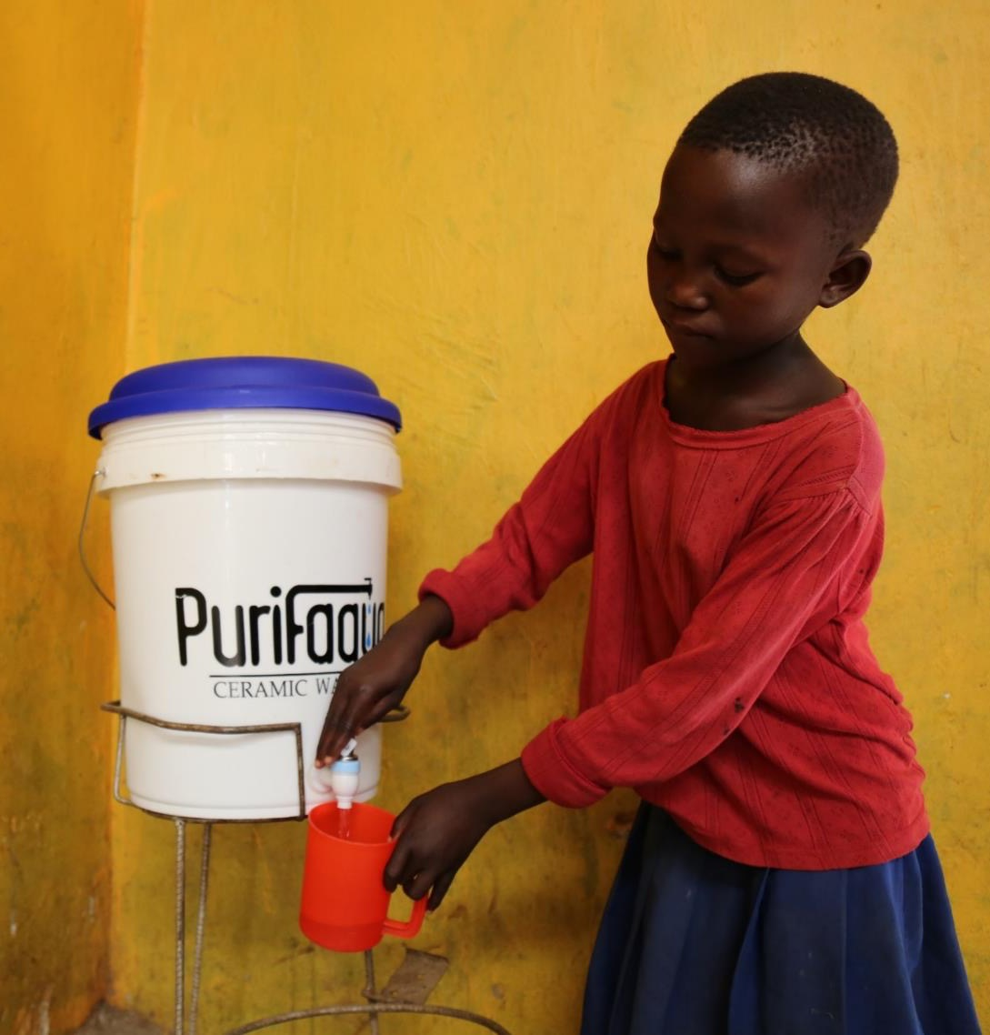
SPOUTS OF WATER
Seul (Kathy) Ku
April 2017
In support by:
Notes:
wonder about Asian American doing in Uganda
2010 - teach, get sick, I can do better
I AM A PROBLEM SOLVER
2011 - design, reluctant entrepreneur
2012 - McK while raising funds, piloted in Kumi
2014 - moved full time
2015 - first sales
It's been a long journey, and today, our team has grown to 45 people working towards a common goal.
And this is OUR story.

Slide 2
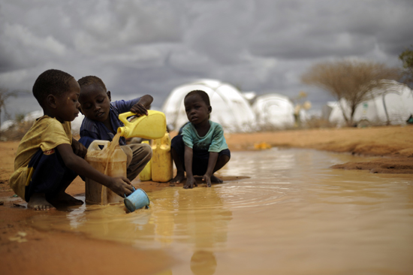
10,000 Deaths / year
360M tons of CO₂ / yr.
$170M Loss
Notes:
Picture = common. Reality = 2 billion people in the world lack water
Uganda = not better
~10,000 deaths every year in Uganda; majority = children under the age of 5. In fact, diarrheal diseases is the 2nd most common cause of death for children under the age of 5.
Start
release 360 million tons of co2 every year, ~75 million cars on the ground.
170 million dollars lost
Additionally, the burden of boiling water falls disproportionally on women and children around the world, taking away time that could be spent elsewhere. Globally, 200 million hours are spent by women and children every single day, fetching water and boiling it.

Slide 3
Problem: Lack of Sustainable Clean Water Solutions
47%
(18M)
4% (1M)
44%
(17M)
53%
(20M)
53%
(20M)
Source: Uganda Bureau of Statistics (UBOS) and ICF International Inc. 2012
Notes:
For the 38 million people living in Uganda, there aren't very many viable solutions.
Tap water is only accessible to about 10% of population, and even that is not safe to drink, so we're looking at the entire population who have to treat their water themselves.
Breaking that down, more than half the population is not treating their water
For the people who are treating their water, a large majority is relying on boiling their water as a means to access safe drinking water
And only about 4% of the population is using different methods such as chlorination or bottled wate

Slide 4
Ceramic Water Filters: Proven and Tested Solution
Effective | Convenient | Cheap | Sustainable
“[Ceramic] filters have the advantages of being light weight, portable, relatively inexpensive, chemical-free, low-maintenance, effective, and easy to use”
- UNICEF
Notes:
This is where we come in.
The Purifaaya, a ceramic water filter manufactured locally in Uganda, is effective, socially accepted given the long-standing tradition of storing water in clay jugs, and affordable at 20 dollars for 2 years of use.
locally manufactured using local materials
A study done by UNICEF found ceramic water filters in general to be lightweight....

Slide 5
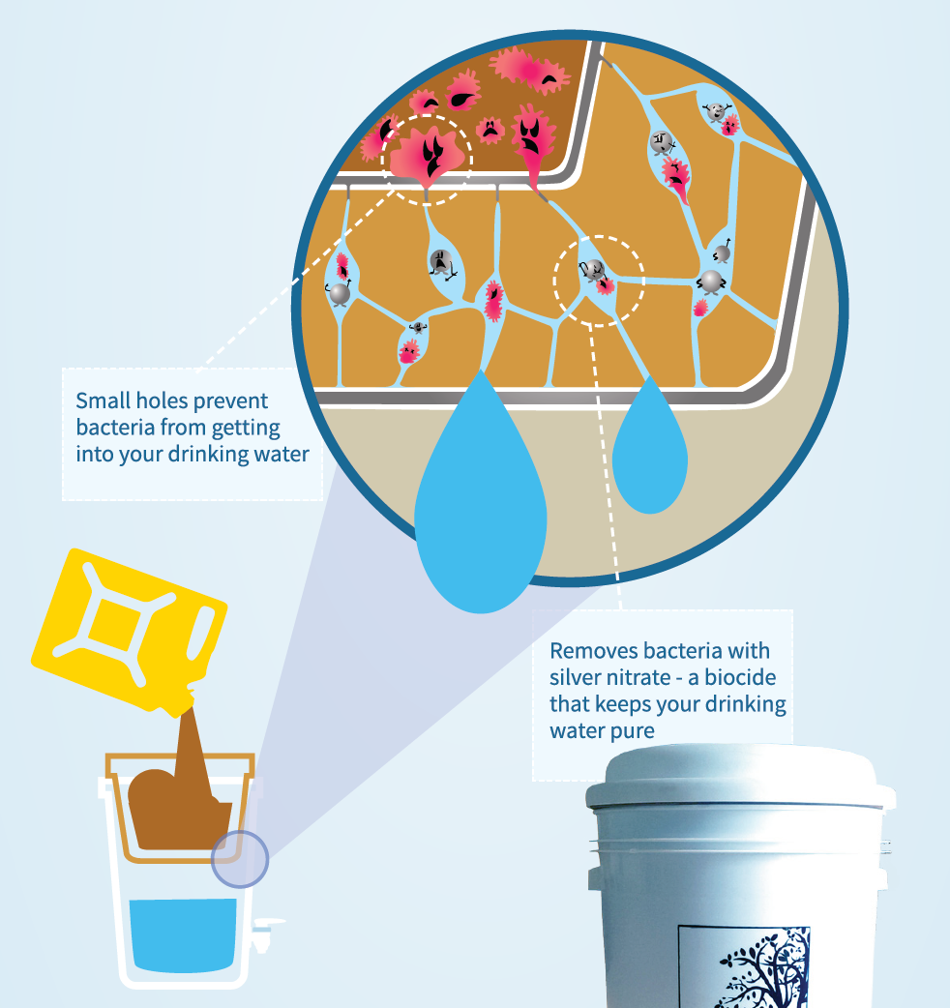
Ceramic Water Filters: Technology Explained
Micro-pores block bacteria
Silver nitrate further disinfect
Notes:
WALK THROUGH FILTER
Clean water stored
Cool water
Leaves behind a slight tast that is preferred

Slide 6
SPOUTS: Vision and Mission
Vision: Universal Clean Water Access
All Ugandans access clean, safe drinking water cheaply and consistently without resorting to boiling
By 2020, SPOUTS of Water aims to have reached
1M Ugandans with our Purifaaya filter
Notes:
By building a supply chain and creating demand for the Purifaaya filter in every home across Uganda and East Africa, our vision is to create universal access to clean drinking water.
And by 2020, our goal is to reach 1 million Ugandans.
Since 2015, we’ve reached more than 100,000 Ugandans, and this wouldn’t have been made possible without our growing team of 45.

Slide 7
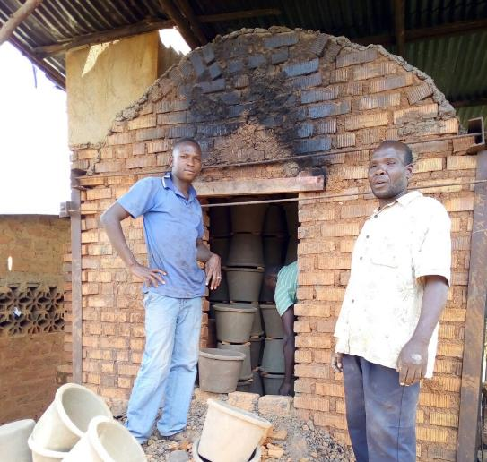
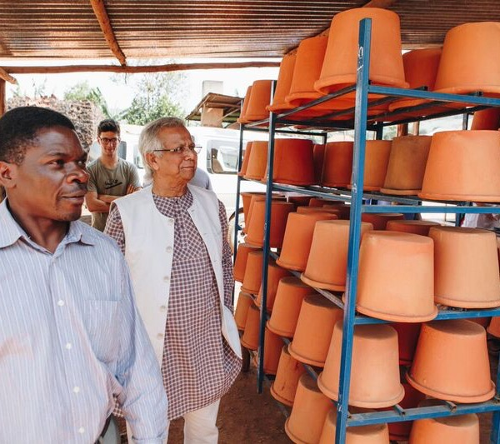
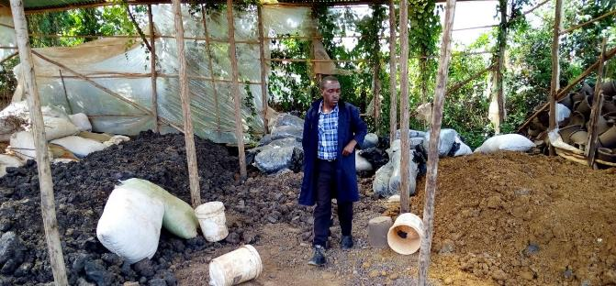
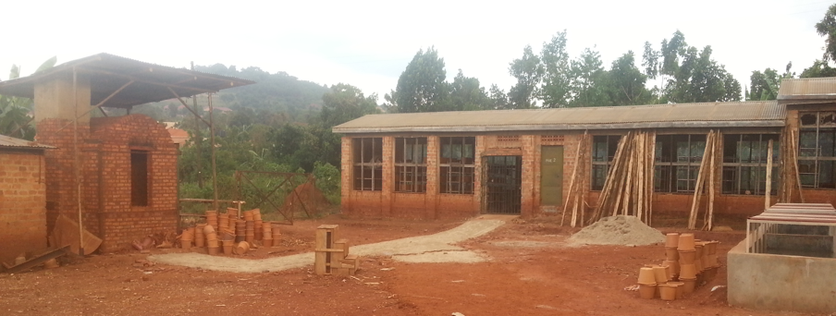
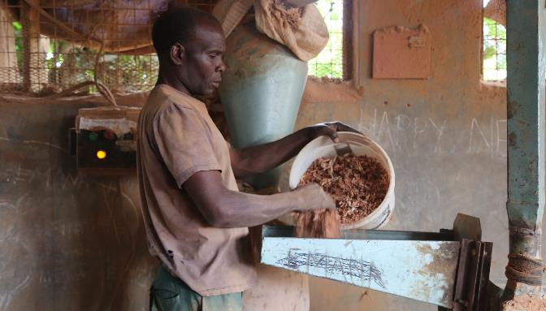
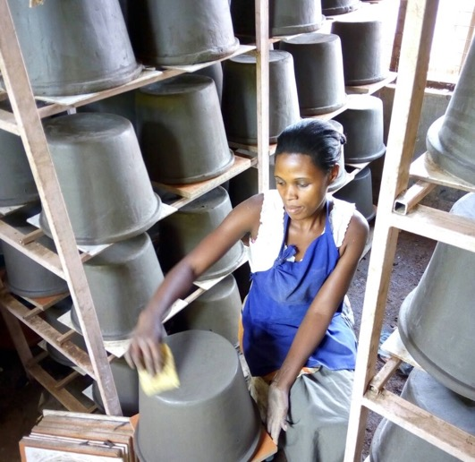
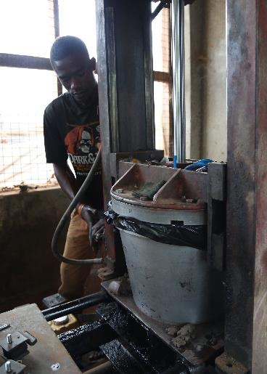
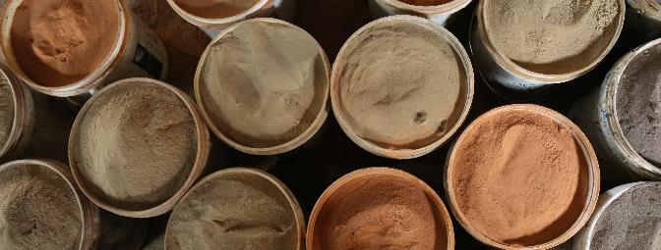
Production: Overview
Notes:
Started off in an old chicken farm
Total Qnty. Produced: 9,671 units
3,043 in ‘15
6,628 in ’16
Annual Growth Rate: 120%
Reasons For Growth:
More assets: machines
More input: workers & hours
Process optimization
Falling failure rate
Forecast: 3x Capacity
15,000+ in 2017
Exponential growth
No space so decided to move

Slide 8
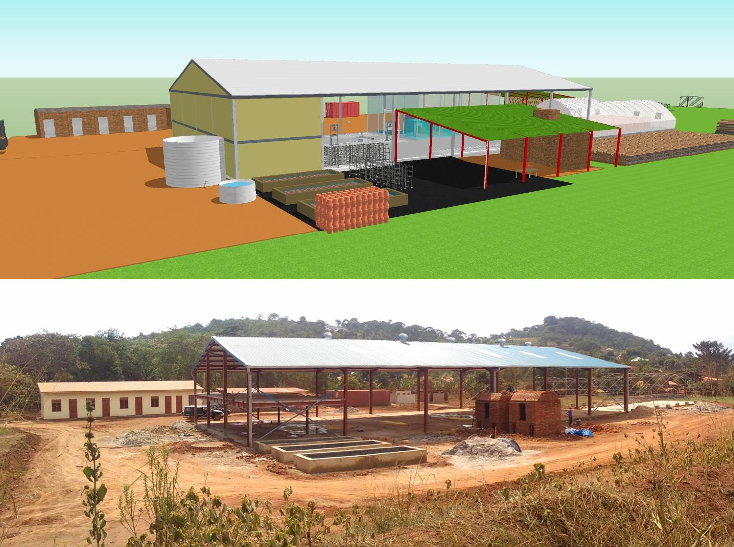
Production: Next Steps
Notes:
Production capacity to move into a new factory where we create very little waste in our entire production process.
Cap = 10,000 filters
Recycle materials to make briquettes for our own firing; broken filters back into process
Developing new products based on feedback from our clients

Slide 9
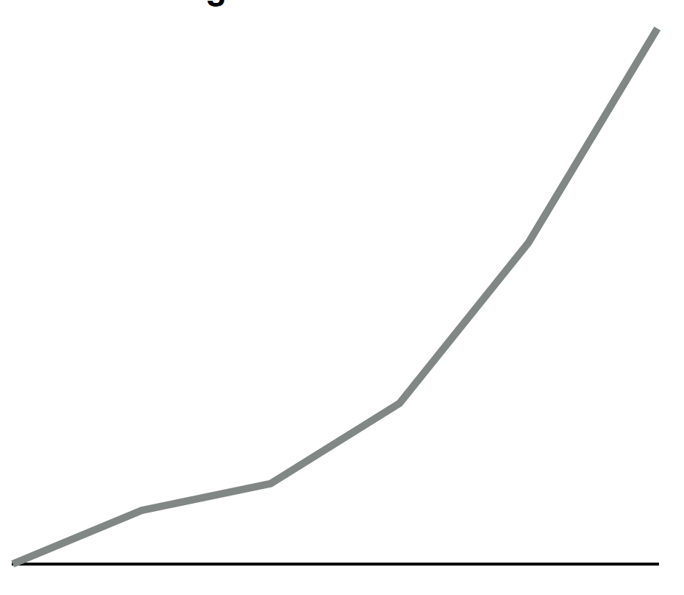
S&M: Overview
Current Landscape
4% (1M)
Avg. Monthly Income per Person (USD)
$300
300
44%
(17M)
Retailers
Social Distrib.
Greater
Urban
1
Retail
2
Financing
Option
MFIs
SACCOs
Peri-
Urban
$100
50
53%
(20M)
NGOs
Gov. entities
Religious orgs.
Rural,
Refugee camps
3
Aided
Sales
Notes:
Retail channels – Vine pharmacies, Supermarkets, Living Goods or BRAC – sell to end users, but door to door model
Financial institutions – MFI - FINCA, SACCOs
AID – Save the Children in schools, UNHCR is refugee camps, religious organizations, district water orgs.
Currently is 250 + retail stores across Uganda – marketing team is providing support so that they can reach our TARGET AUDIENCE - MOTHERS
Total is 8 million households just in Uganda. Beyond Uganda, we have retailers in DRC / south sudan.
Our sales team dreams big – they didn’t exist a year ago, and today, their goal is to dominate the East Africa market.
---
This wouldn’t be possible without our Operations team, whom I’m really proud of. This is led by Maya Bretzius, who has more than 4 years in Management consulting at BCG and Save the Children.
Problem solver – methodical. Create a replicable model that is proven – extends to our financials, even our Human resources, and especially our impact

Slide 10
Operations: KPIs – Impact
54K fewer cases
of diarrhea
65K fewer tons
of CO2
$1.1M saved
50K hours saved
Notes:
44K are children
Impact assessment collab with Ignosi + prof @ UC berkeley
---
2 years sales of 10,000 filters – expectation = double in 2017 alone

Slide 11
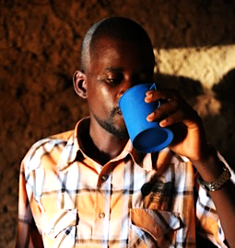
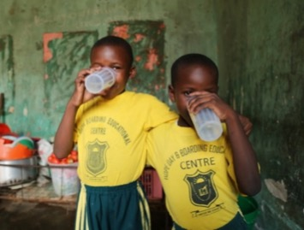
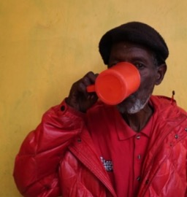
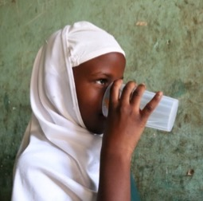
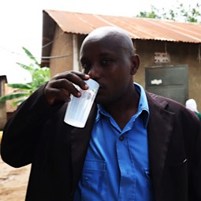
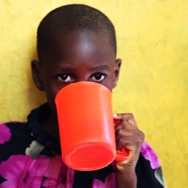
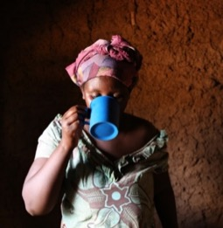
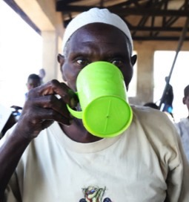
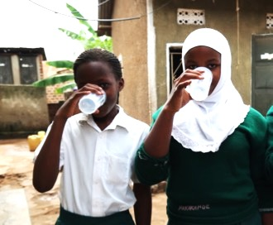
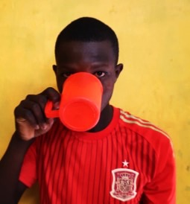
THANK YOU

